Slide 1

College of Computer and Information Sciences
Department of Computer Science
CSC 220: Computer Organization
Unit 6
COMBINATIONAL CIRCUITS-2

Slide 2
Objectives
Multiplexers
DeMultiplexers
Decoders
Encoders

Slide 3
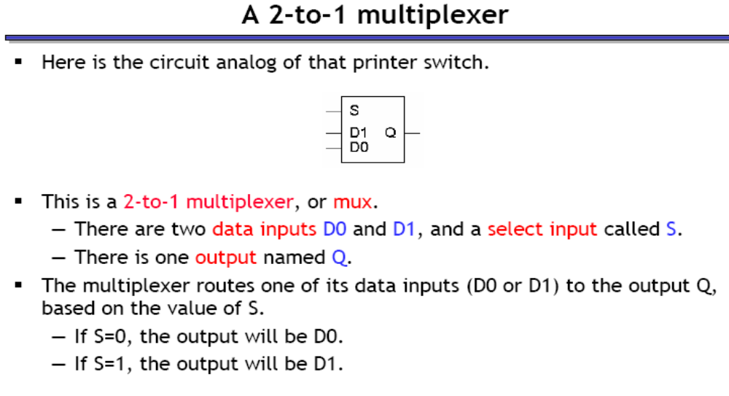

Slide 4
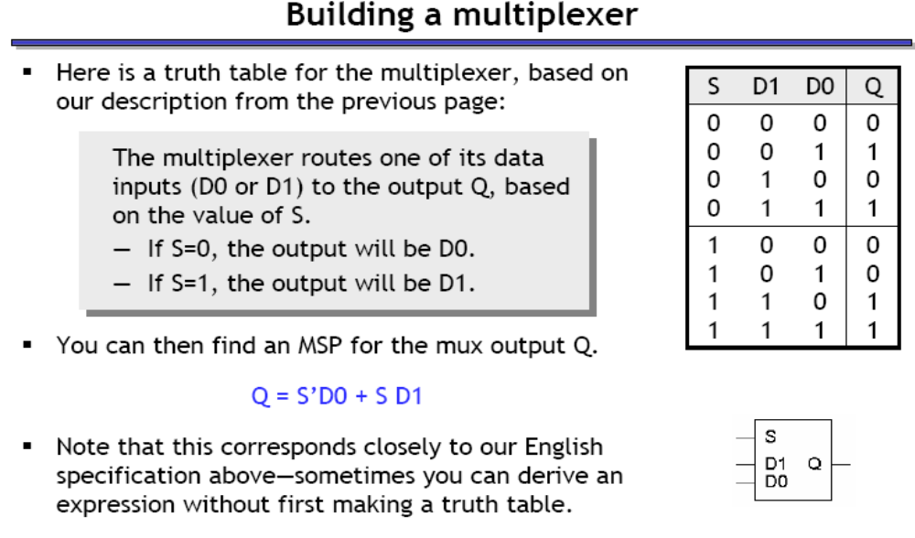

Slide 5
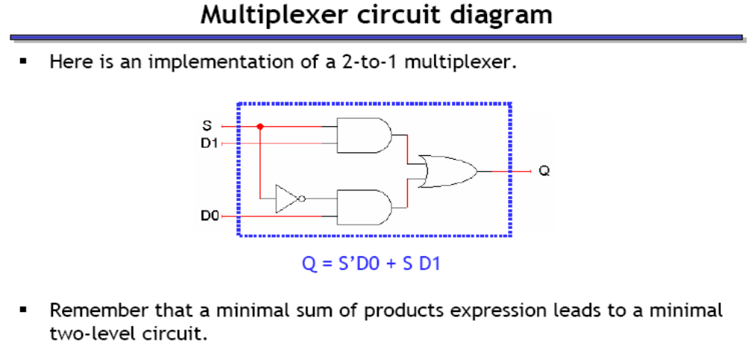

Slide 6
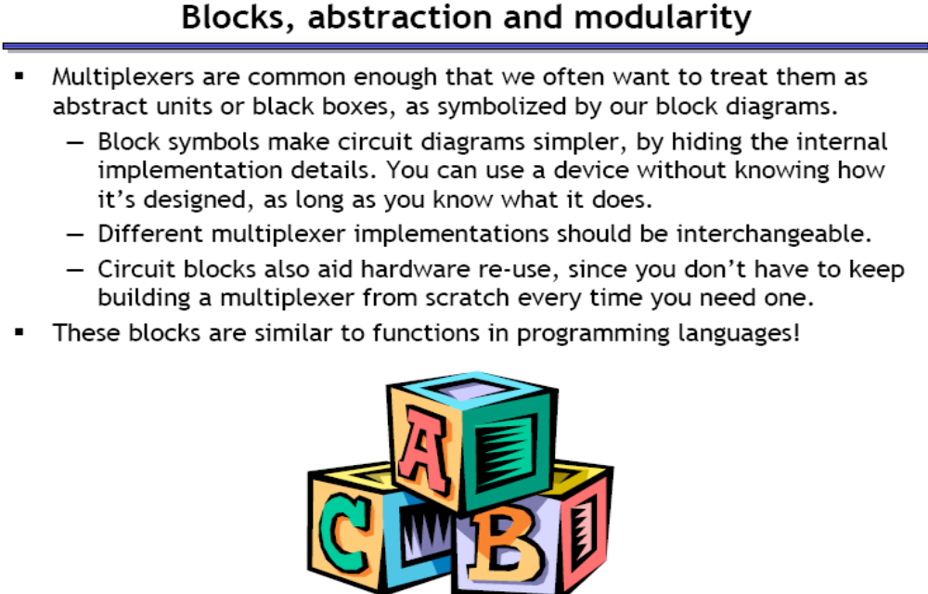

Slide 7
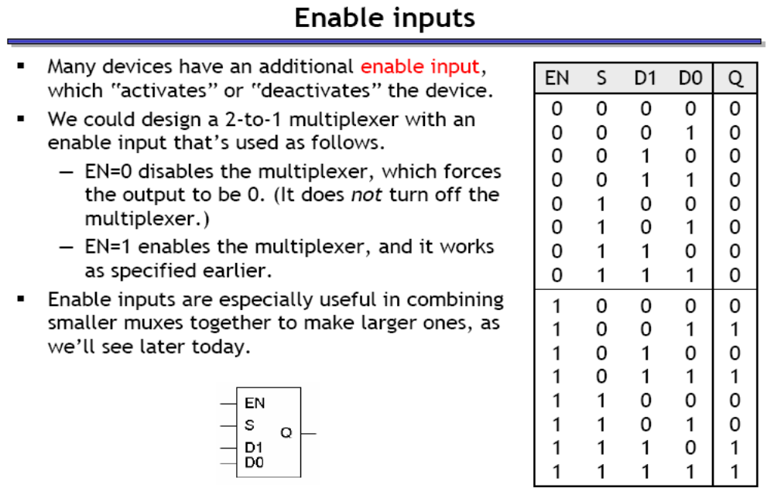

Slide 8
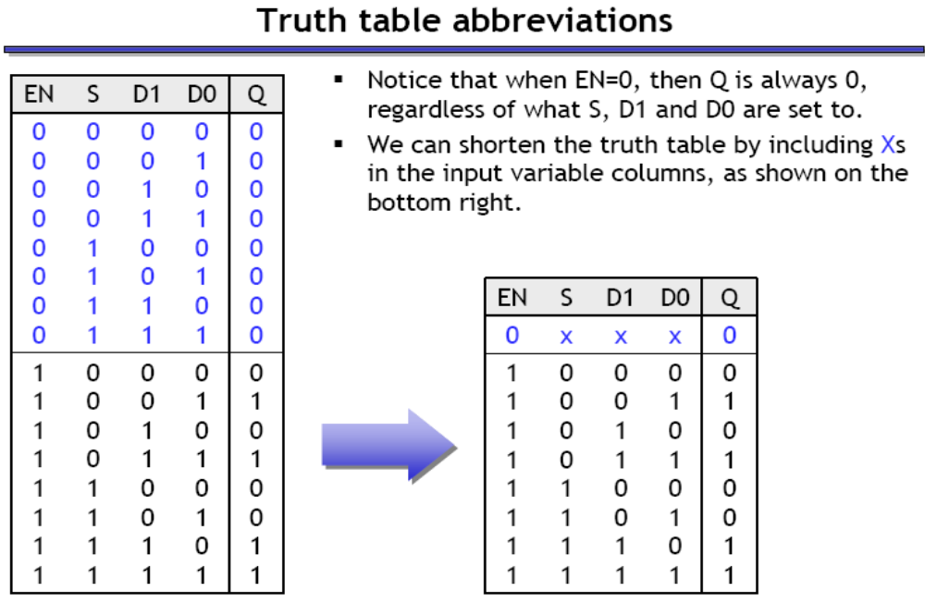

Slide 9
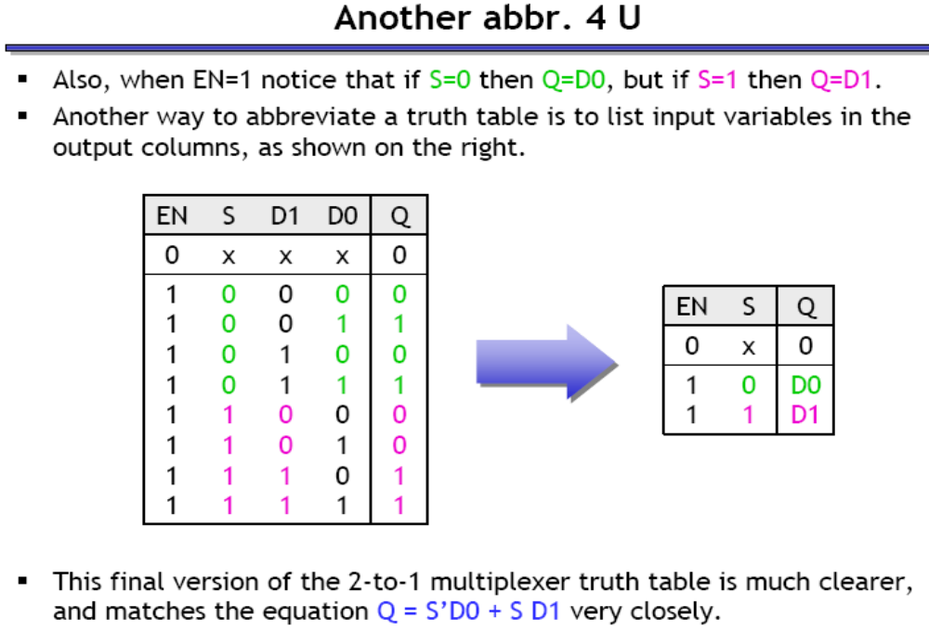

Slide 10
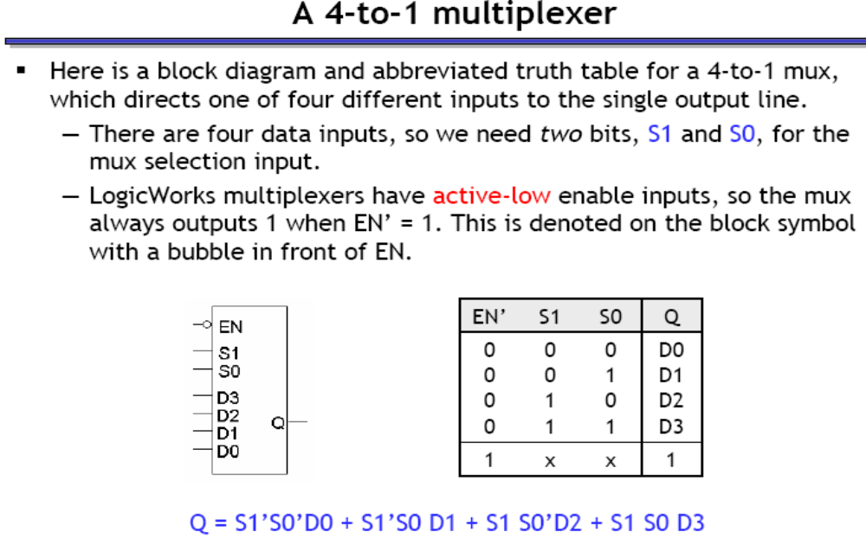

Slide 11
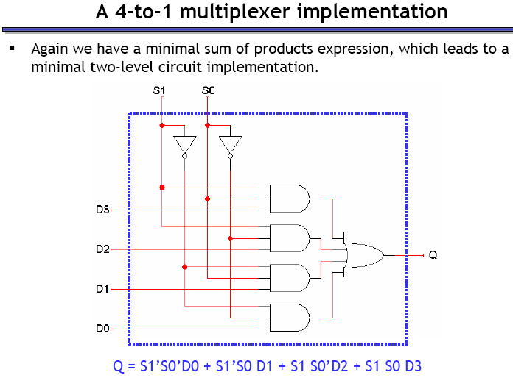

Slide 12
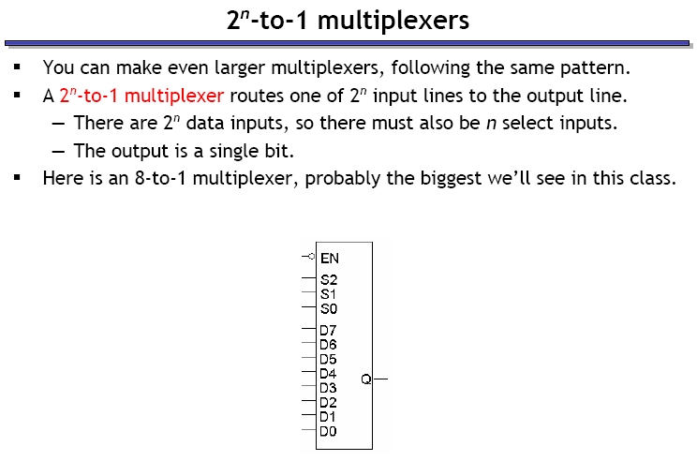

Slide 13
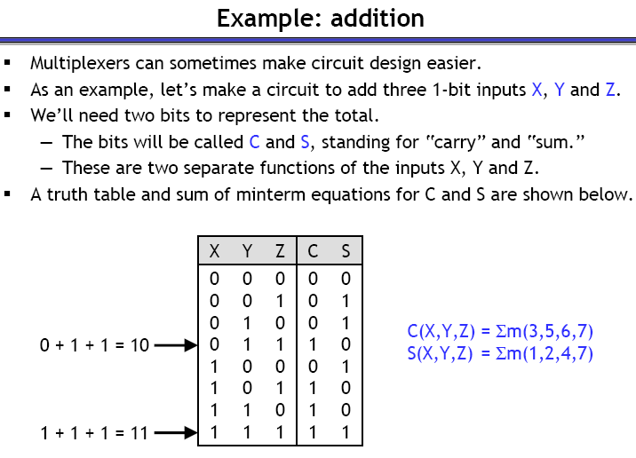
Implementing Functions with Multiplexers
Prof. Laxmikant Kale - university of illinois at urbana-champaign - Computer Sciences

Slide 14
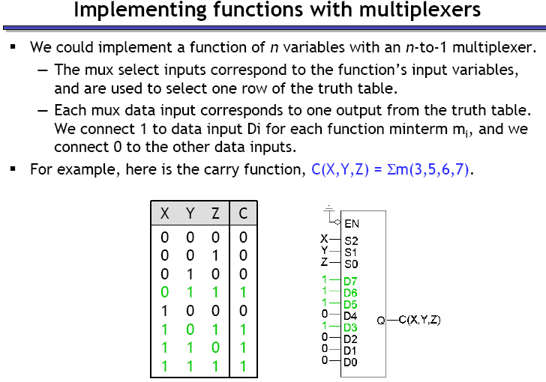
Dr Mohamed A Berbar

Slide 15
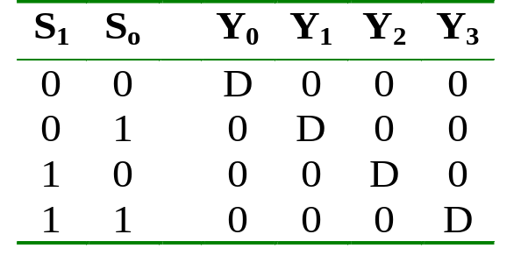
Demultiplexer
Given an input line and a set of selection lines, the demultiplexer will direct data from input to a selected output line.
An example of a 1-to-4 demultiplexer:
Outputs
Y₀ = D.S₁'.S₀'
Y₁ = D.S₁'.S₀
Data D
demux
Y₂ = D.S₁.S₀'
Y₃ = D.S₁.S₀
S₁ S₀
select
Demultiplexer
CS1104-7

Slide 16
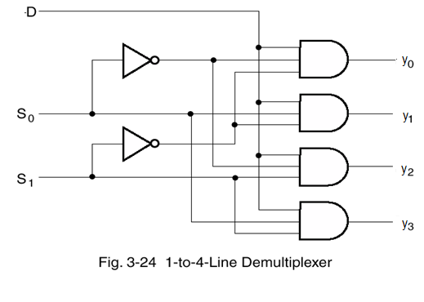
Demultiplexer
Takes one input
Out to one of 2^{n} possible outputs

Slide 17
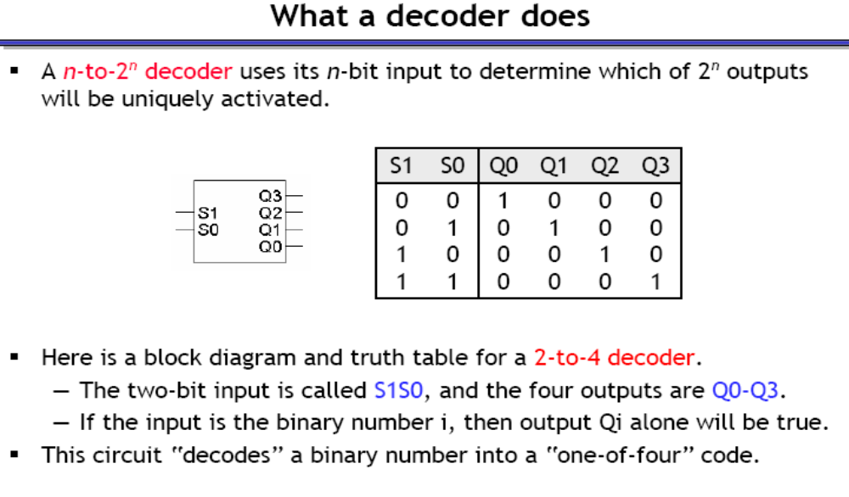
Decoder

Slide 18
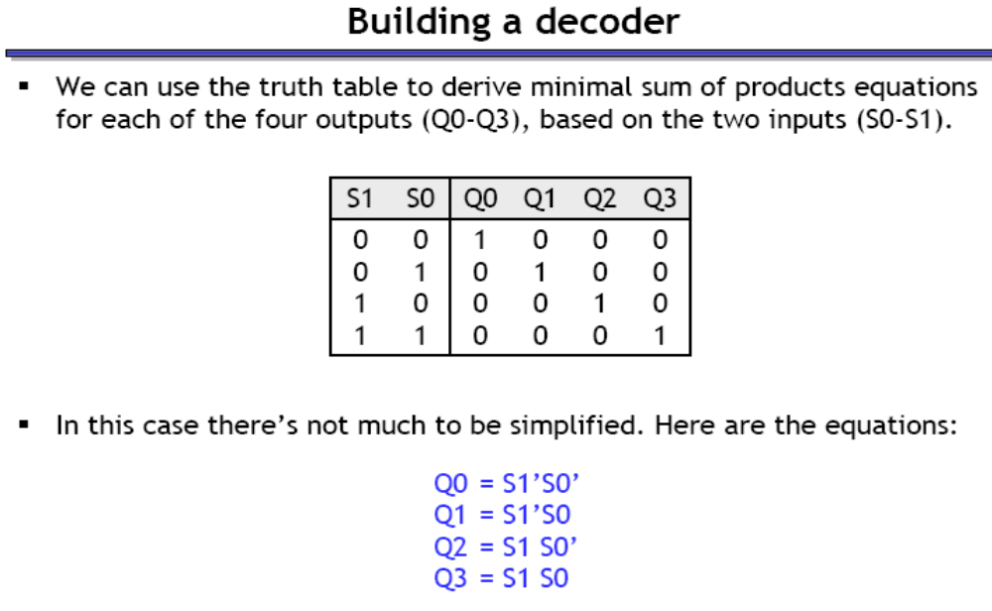

Slide 19
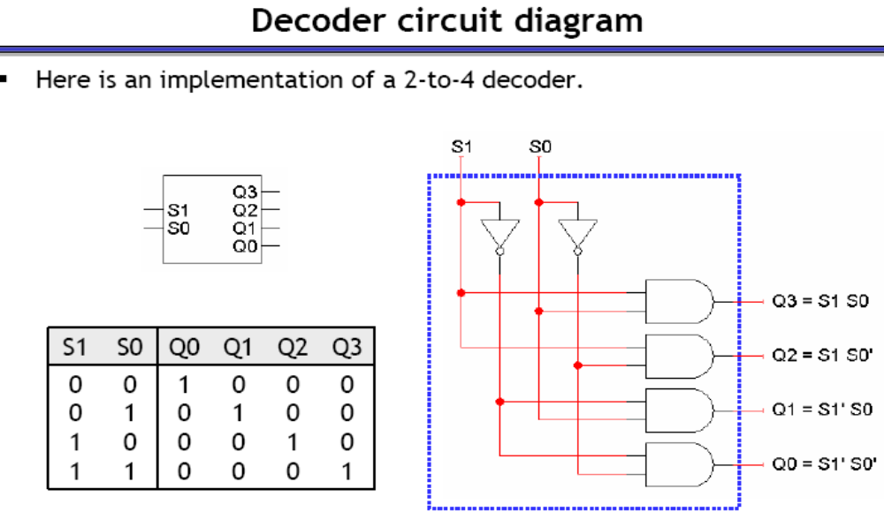

Slide 20
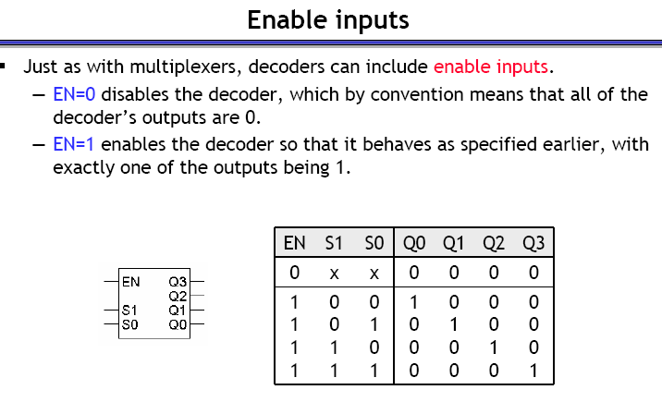

Slide 21
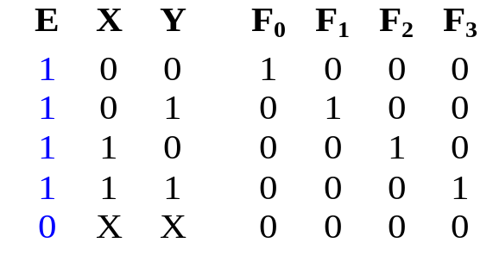
Decoders with Enable (1/2)
Decoders often come with an enable signal, so that the device is only activated when the enable, E=1.
Truth table:
F₀ = EX'Y'
F₁ = EX'Y
F₂ = EXY'
F₃ = EXY
Circuit:
X
Y
E
Decoders with Enable

Slide 22
Demultiplexer Vs Decoder
The demultiplexer is actually identical to a decoder with enable, as illustrated below:
Y₀ = D.S₁'.S₀'
2x4 Decoder
S₁
S₀
Y₁ = D.S₁'.S₀
Y₂ = D.S₁.S₀'
E
Y₃ = D.S₁.S₀
D
Exercise: Provide the truth table for above demultiplexer.
Demultiplexer
CS1104-7

Slide 23
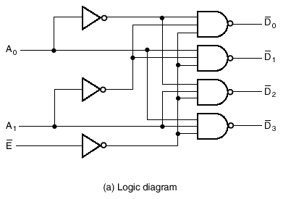
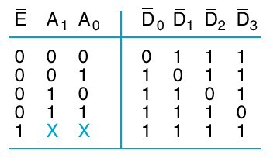
A Demux Using NAND Gates:
A Decoder with an Enable

Slide 24
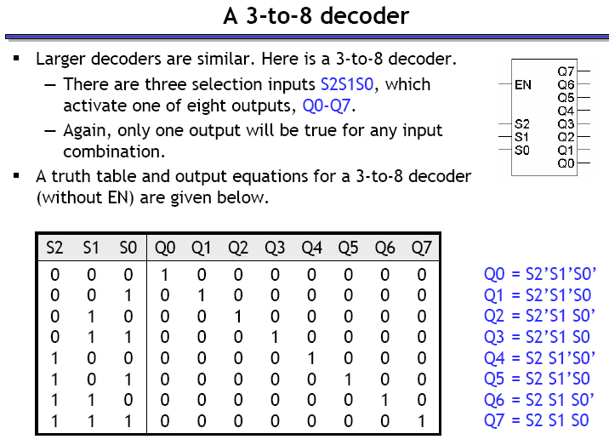

Slide 25
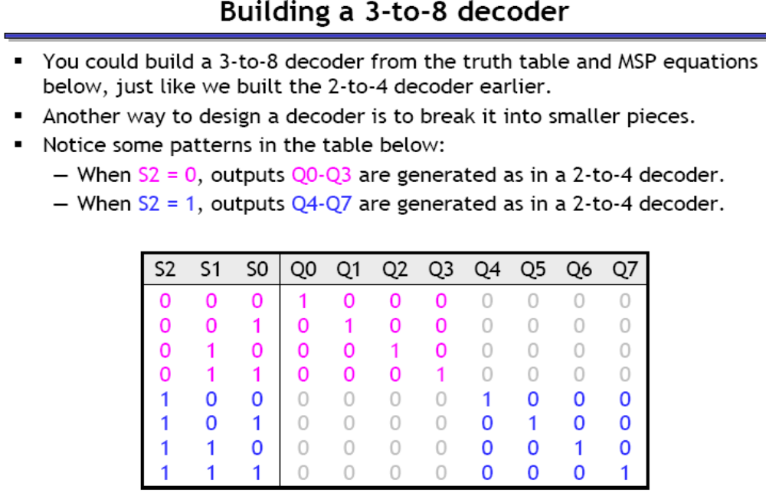

Slide 26
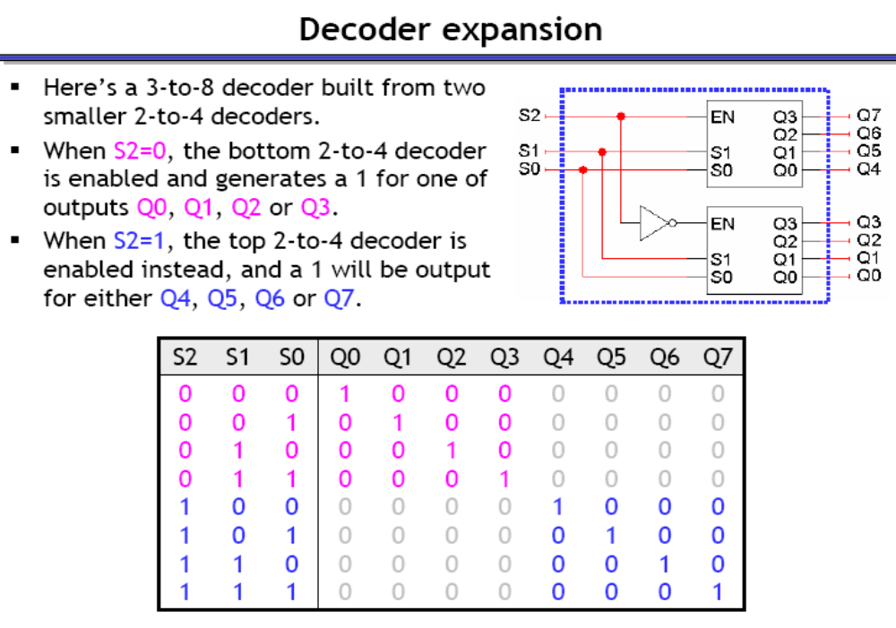
Dr Mohamed A Berbar

Slide 27
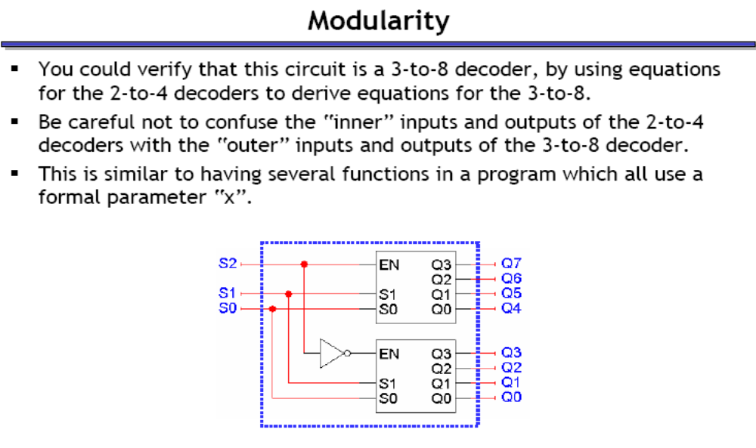

Slide 28
Larger Decoders (2/6)
3x8
Dec
0
1
:
:
7
F₀ = w'x'y'
F₁ = w'x'y
:
:
F₇ = wxy
w
x
y
S₂
S₁
S₀
0
0
0
2x4
Dec
1
0
0
0
w
x
y
0
1
2
3
F₀ = w'x'y'
F₁ = w'x'y
F₂ = w'xy'
F₃ = w'xy
S₁
S₀
E
1 = enabled
2x4
Dec
0
0
0
0
0
1
2
3
F₄ = wx'y'
F₅ = wx'y
F₆ = wxy'
F₇ = wxy
S₁
S₀
E
0 = disabled
Larger Decoders

Slide 29
Larger Decoders (3/6)
3x8
Dec
0
1
:
:
7
F₀ = w'x'y'
F₁ = w'x'y
:
:
F₇ = wxy
w
x
y
S₂
S₁
S₀
0
0
1
2x4
Dec
0
1
0
0
w
x
y
0
1
2
3
F₀ = w'x'y'
F₁ = w'x'y
F₂ = w'xy'
F₃ = w'xy
S₁
S₀
E
1 = enabled
2x4
Dec
0
0
0
0
0
1
2
3
F₄ = wx'y'
F₅ = wx'y
F₆ = wxy'
F₇ = wxy
S₁
S₀
E
0 = disabled
Larger Decoders
CS1104-7

Slide 30
Larger Decoders (4/6)
3x8
Dec
0
1
:
:
7
F₀ = w'x'y'
F₁ = w'x'y
:
:
F₇ = wxy
w
x
y
S₂
S₁
S₀
1
1
0
2x4
Dec
0
0
0
0
w
x
y
0
1
2
3
F₀ = w'x'y'
F₁ = w'x'y
F₂ = w'xy'
F₃ = w'xy
S₁
S₀
E
0 = disabled
2x4
Dec
0
0
1
0
0
1
2
3
F₄ = wx'y'
F₅ = wx'y
F₆ = wxy'
F₇ = wxy
S₁
S₀
E
1 = enabled
Larger Decoders
CS1104-7

Slide 31
Larger Decoders (5/6)
Question:
Construct a 4x16 decoder from two 3x8 decoders with 1-enable.
4x16
Dec
w
x
y
z
S₃
S₂
S₁
S₀
0
1
:
:
15
F₀
F₁
:
:
F₁₅
3x8
Dec
w
x
y
z
0
1
:
7
F₀
F₁
:
F₇
S₂
S₁
S₀
E
3x8
Dec
S₂
S₁
S₀
0
1
:
7
F₈
F₉
:
F₁₅
E
Larger Decoders
CS1104-7

Slide 32
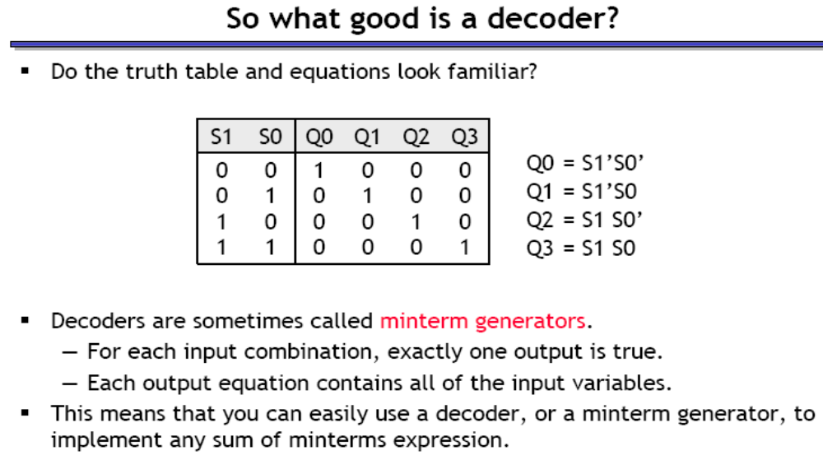

Slide 33
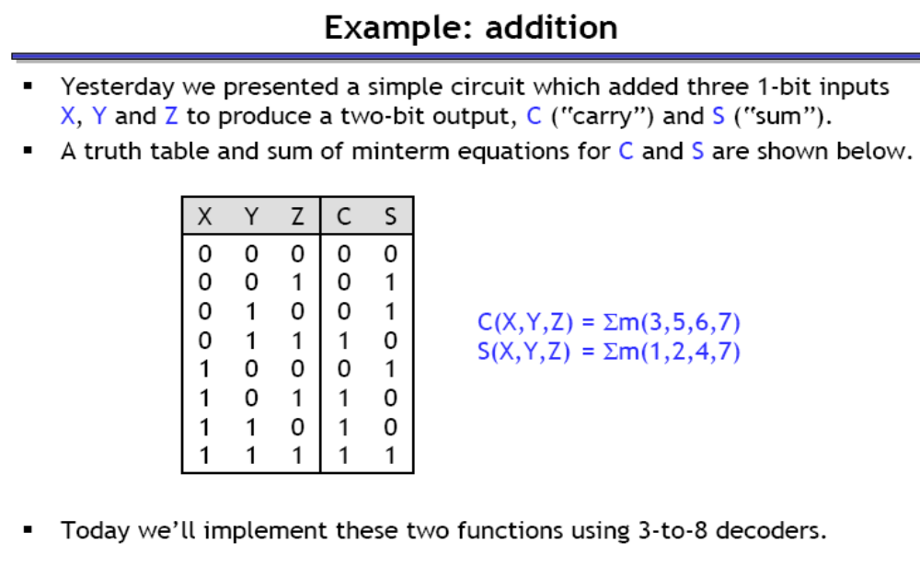
Implementing Functions with Decoder
Prof. Laxmikant Kale - university of illinois at urbana-champaign - Computer Sciences

Slide 34
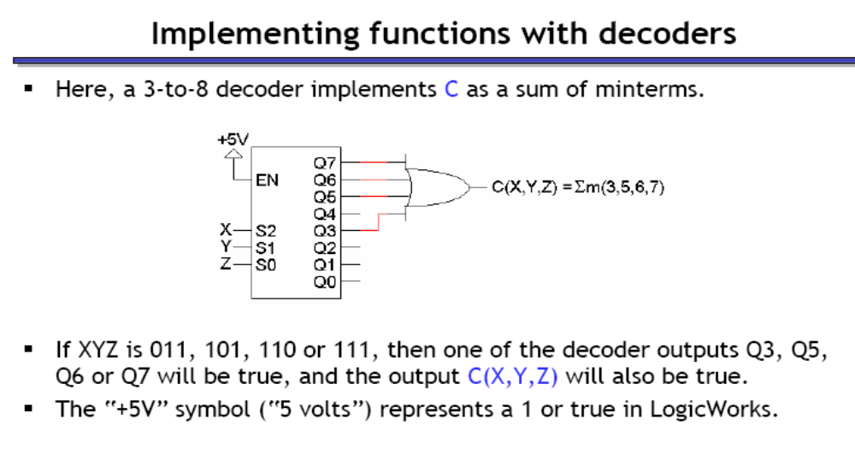
Dr Mohamed A Berbar

Slide 35
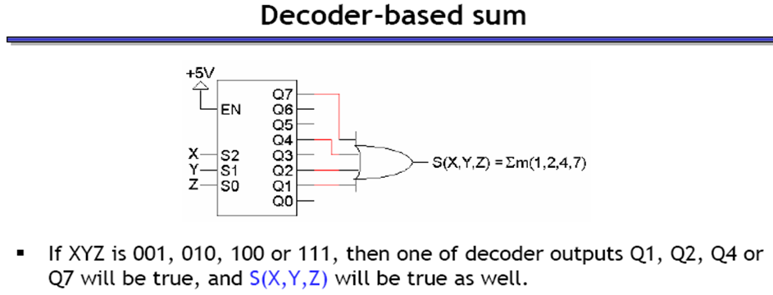

Slide 36
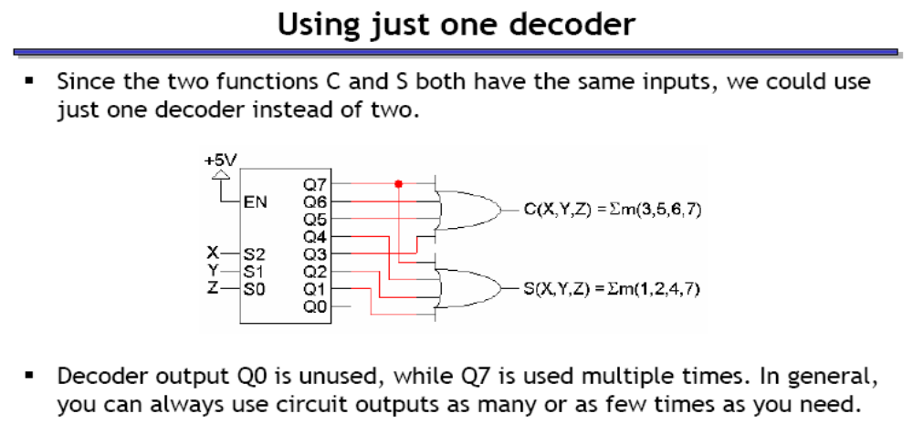

Slide 37
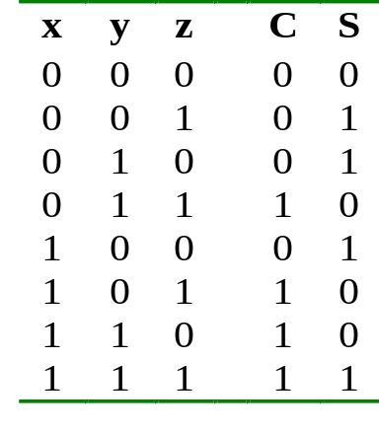
Decoders: Implementing Functions
Example: Full adder
3x8
Dec
0
1
2
3
4
5
6
7
1
0
0
0
0
0
0
0
S
0
0
0
0
x
S₂
S₁
S₀
y
C
0
z
Decoders: Implementing Functions
CS1104-7

Slide 38
Decoders: Implementing Functions
3x8
Dec
0
1
2
3
4
5
6
7
0
0
0
0
0
0
0
1
S
1
1
1
1
x
S₂
S₁
S₀
y
C
1
z
Decoders: Implementing Functions
CS1104-7

Slide 39
Example:
F(a,b,c) = ∑ m(4,6,7)
Using a 3×8 decoder (assuming 1-enable and active-high outputs).
3x8
Dec
0
1
2
3
4
5
6
7
a
S₂
S₁
S₀
b
F
c
EN
1
Reducing Decoders
CS1104-7

Slide 40
Encoder
Encoder is the opposite of decoder
2^{n} inputs
  or less – 10 inputs in “Decimal to BCD” encoder: I₀, I₁, I₂, I₃, …, I₉
n outputs
  4 output lines “Decimal to BCD”encoder

Slide 41
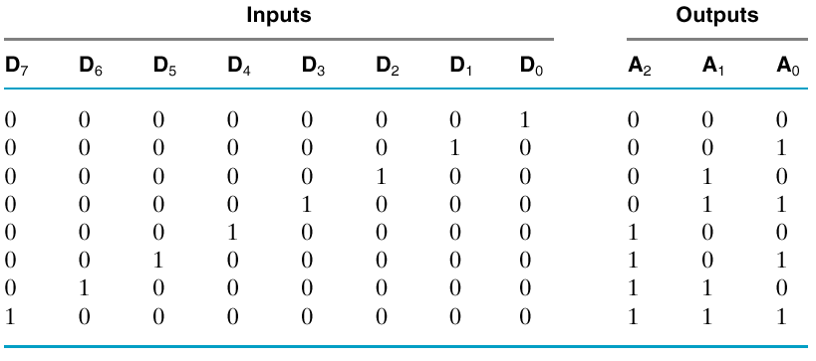
Truth Table: 8-to-3 Binary Encoder

Slide 42
Inputs are Minterms
Can OR the minterms appropriately to get each of the outputs A₀, A₁, A₂
Example: A₀ = D₁ + D₃ + D₅ + D₇

Slide 43
Generating Outputs using OR of Minterms
A₀ = D₁ + D₃ + D₅ + D₇
A₁ = D₂ + D₃ + D₆ + D₇
A₂ = D₄ + D₅ + D₆ + D₇

